Slide 1

Features of Quorum
1

Slide 2

Features of Quorum
PERFORMANCE
PRIVACY
PERMISSIONED
COST-EFFECTIVE

Slide 3
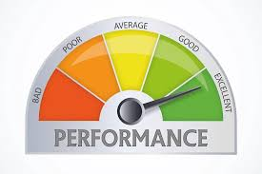
Performance
The number of transactions processed can be enhanced significantly. A hundred transactions per
second can be managed easily.
Transaction speed can be designed according to smart contracts and network arrangement.
By using vote-based QuorumChain RAFT and Istanbul BFT consensus algorithms, performance can
be improved.

Slide 4

Privacy
Quorum provides both transaction level privacy and network wide transparency.
Uses zero-knowledge security layer to ensure that private settlement is done
Quorum manages secure message transfers using constellation.
smoothly.
For enhancing transaction level privacy, transactions are divided into private and public transactions
depending on the nature of transaction data.

Slide 5
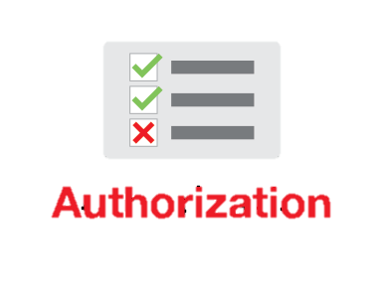

Permission and Authorization
Network is not open to all; only authorized users can access the data.
Peers have to take the permission from a designated authority such as a entering into a network.
Network Manager,
before
The permission nature of Quorum is fundamentally associated with the consensus mechanism.
Authorization can also be managed through a smart contract.

Slide 6

Cost-effective
No concept of adding cost to a transaction using gas.
No cryptocurrency costs associated with running transactions.

Slide 7
THANK YOU!

